Slide 1

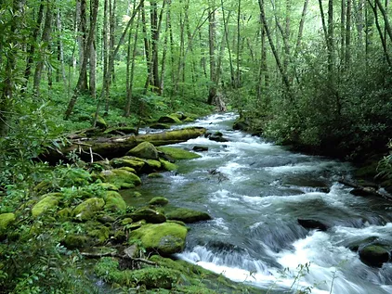
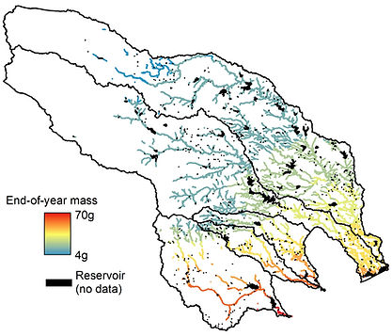
R Applications in Ecology and Env Science
Matt Troia
Assistant Professor
Dept Integrative Biology
Fish ecology and conservation
matthew.troia@utsa.edu
www.troiaecology.org

Slide 2
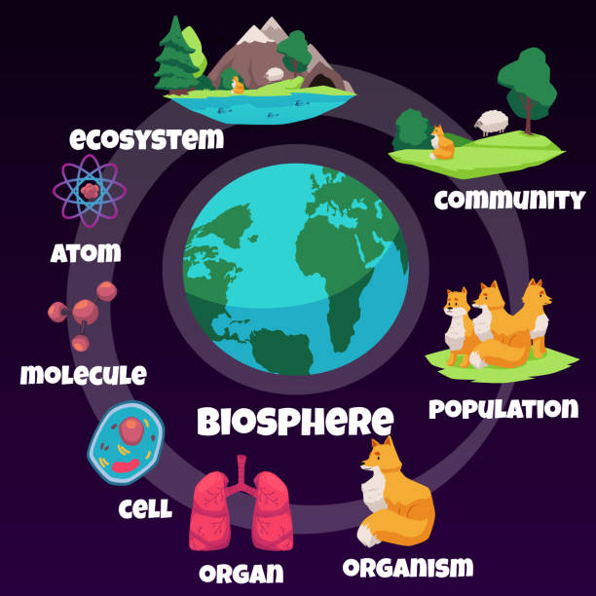
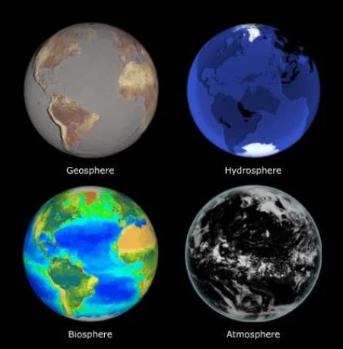
R Applications in Ecology and Env Science
iStock
SERC
Humanity

Slide 3
The site-by-species matrix
iStock

Slide 4
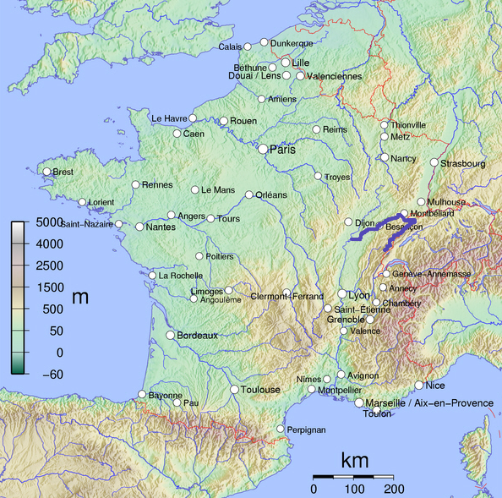
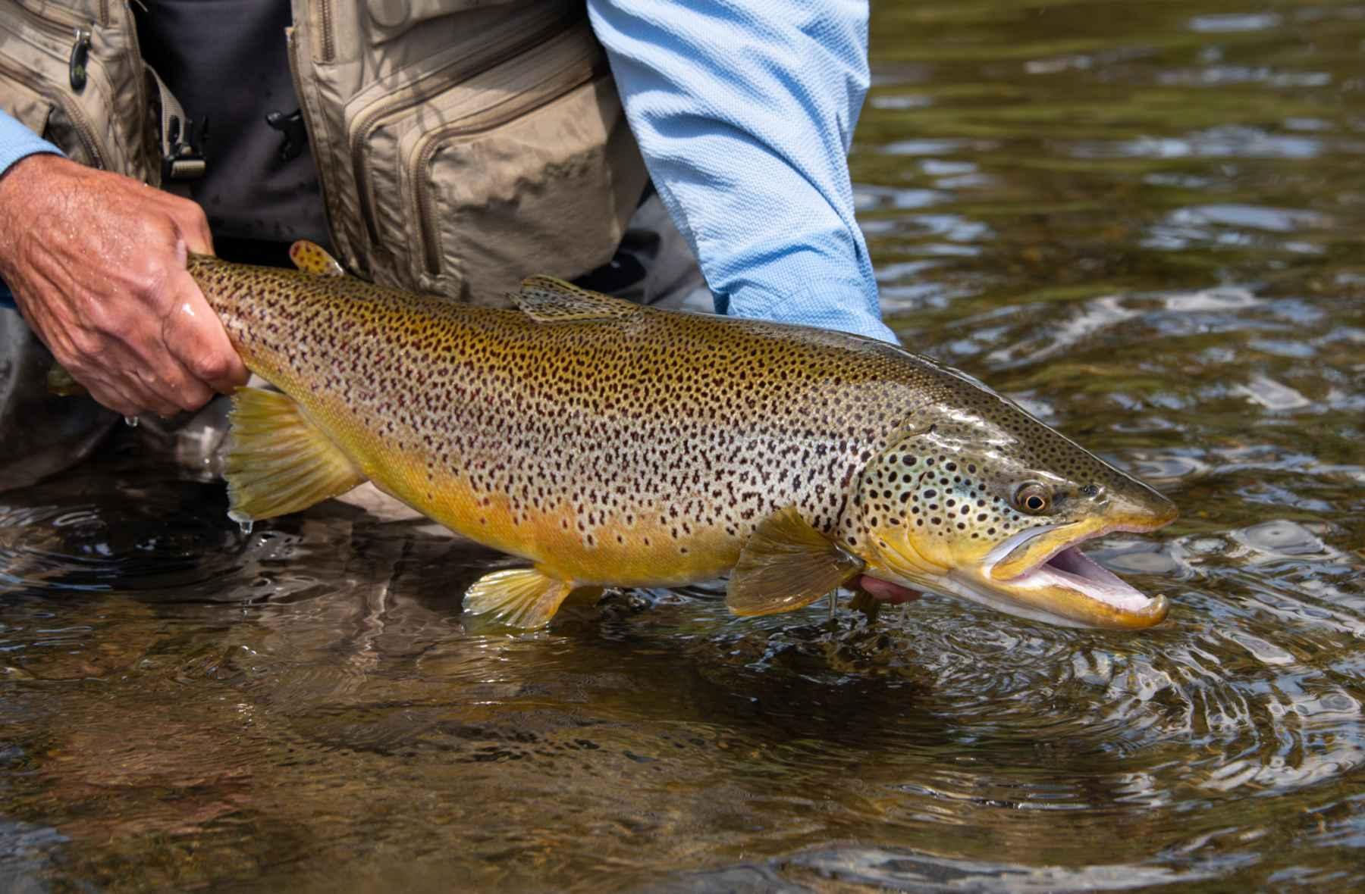
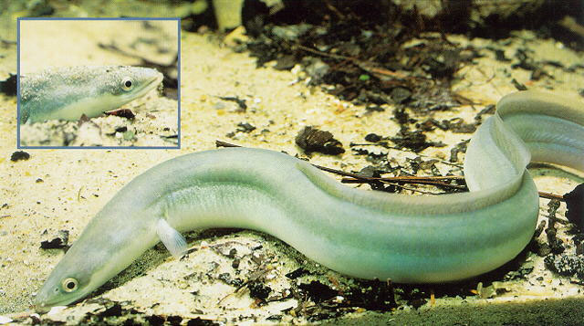
Doubs fish species
vikedia
Hatch Magazine
USGS

Slide 5
The site-by-species matrix → Advanced

Slide 6
Bioclim variables
BIO1 = Annual Mean Temperature
BIO2 = Mean Diurnal Range (Mean of monthly (max temp - min temp))
BIO3 = Isothermality (BIO2/BIO7) (×100)
BIO4 = Temperature Seasonality (standard deviation ×100)
BIO5 = Max Temperature of Warmest Month
BIO6 = Min Temperature of Coldest Month
BIO7 = Temperature Annual Range (BIO5-BIO6)
BIO8 = Mean Temperature of Wettest Quarter
BIO9 = Mean Temperature of Driest Quarter
BIO10 = Mean Temperature of Warmest Quarter
BIO11 = Mean Temperature of Coldest Quarter
BIO12 = Annual Precipitation
BIO13 = Precipitation of Wettest Month
BIO14 = Precipitation of Driest Month
BIO15 = Precipitation Seasonality (Coefficient of Variation)
BIO16 = Precipitation of Wettest Quarter
BIO17 = Precipitation of Driest Quarter
BIO18 = Precipitation of Warmest Quarter
BIO19 = Precipitation of Coldest Quarter

Slide 7
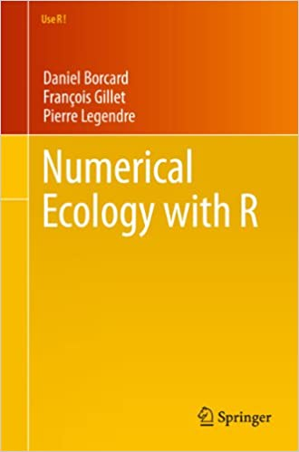

More R resources
Libraries
vegan
ape
nhdR
waterData
rgbif
raster
ggplot2
lubridate

